Slide 1

WGU MSDA D214 GRADUATE CAPSTONE JAN FRANCIS MITCHELL BARLAAN WESTERN GOVERNORS UNIVERSITY

Slide 2
Twitter Sentiment & STOCK
Twitter Sentiment analysis on company stock - SENTIMENT ANALYSIS WITH NEURAL NETWORKS & VADER

Slide 3
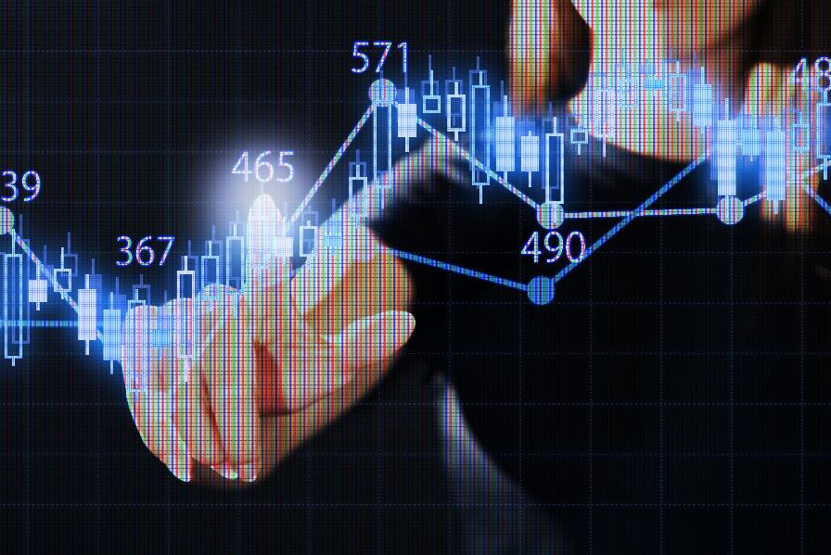
problem
Using neural networks such as LSTM combined with other sentiment analysis techniques such as VADER, can we create a model that can accurately predict people's current sentiments and feelings towards investing in a company's stock, whether positive or negative, based on social media texts such as their tweets?

Slide 4
Hypotheses
Null hypothesis (H0) - Using neural networks and VADER, we cannot create a model that can accurately predict the sentiment behind a tweet or review with at least 70% accuracy.
Alternate Hypothesis (H1) - Using neural networks and VADER, we can successfully create a model that can accurately predict the sentiment behind a tweet or review with at least 70% accuracy.

Slide 5
SUMMARY OF DATA ANALYSIS PROCESS
The Twitter data used in this analysis was obtained publicly through Kaggle
The raw data was composed of 80,794 different observations. Each observation included the following information: the Date, Tweet, Stock Name, and Company Name.

Slide 6
SUMMARY OF DATA ANALYSIS PROCESS CONT.
Data cleaning, EDA, and preprocessing was performed.
VADER Sentiment Intensity Analyzer was used to label the tweet sentiments since the raw data was unlabeled in regards to sentiment.
The data was split into training, validation, and test sets.
The final neural network built was a CNN-Bidirectional LSTM.
The test set was used to assess the ability of the final model in predicting a tweet’s sentiment in comparison to the actual sentiment labeled earlier by VADER.

Slide 7
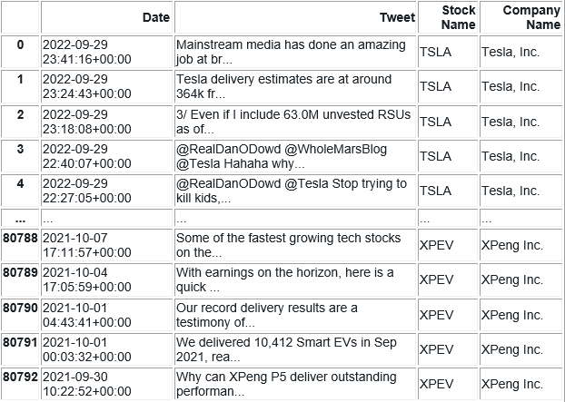
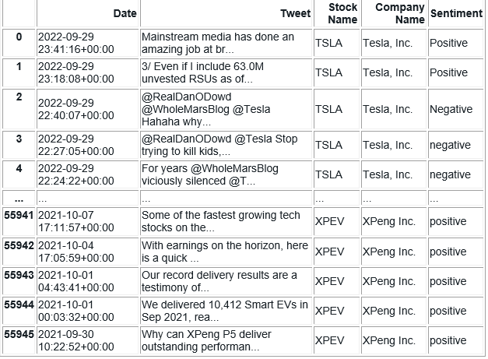
RAW DATA SET (left) AND vader sentiment labeling (right)

Slide 8
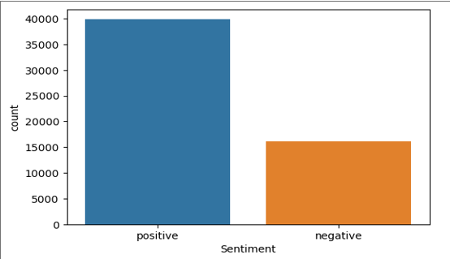
Vader sentiment distribution

Slide 9
SUMMARY OF DATA ANALYSIS PROCESS – FINAL MODEL
The final neural network built was a CNN-Bidirectional LSTM.
The constructed model could predict sentiment with an accuracy of about 98.6% on the train set, about 88.7% on the validation set, and about 88.7% again on the test set. Test loss was about 35.8%.
The test set was used to assess the ability of the final model in predicting a tweet’s sentiment in comparison to the actual sentiment labeled earlier by VADER.

Slide 10
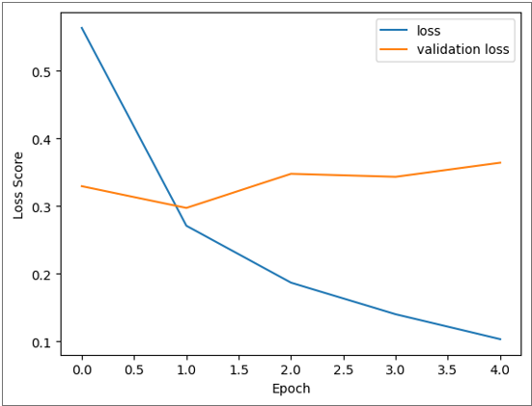
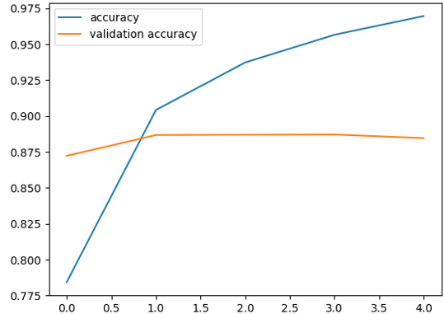
Model performance – Validation loss & accuracy

Slide 11
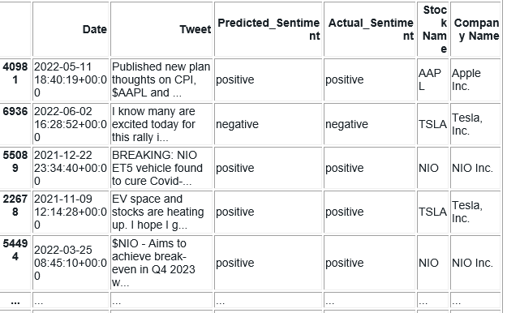
Model performance – predicted vs actual sentiment

Slide 12
FINDINGS
The constructed model could predict sentiment with an accuracy of about 98.6% on the train set, about 88.7% on the validation set, and about 88.7% again on the test set. Test loss was about 35.8%.

Slide 13
FINDINGS – REVISITING HYPOTHESES
In the context of the original research question and the initial model built to answer it, using neural networks and VADER, we can successfully create a model that can accurately predict the sentiment behind a tweet or review with at least 70% accuracy.
Therefore, we can reject the null and accept the alternative hypothesis since our accuracies between the train, test, and validation sets all score significantly above 70% accuracy.

Slide 14
LIMITATION OF CHOSEN ANALYSIS
One major limitation of the chosen analysis stems from the initial sentiment labeling performed by VADER's Sentiment Intensity Analyzer. This step was unavoidable and necessary since the tweets in the raw data set had no prior sentiment labeling applied to them.
In a worst-case scenario, improper/inaccurate labeling of VADER could lead to bigger trickle-down effects as the data is fed into more complicated models, such as the neural networks we employed.
However, this inherent weakness was also the reason for selecting a combination of convoluted and recurrent neural network features. Hybrid solutions between VADER and these neural network architectures were chosen to use the strength of one to cover the inherent weakness of another in a complementary fashion.

Slide 15
Proposed actions
According to the results of the analyses, the hybrid approach using lexicon-based tools such as VADER in combination with neural networks is quite capable of creating a model with high accuracy for sentiment analysis.
One neural network architecture we may be interested in attempting this approach with is Transformers. One intriguing key feature of this specific architecture is that it can parallel processes and uses an attention mechanism that focuses on different parts of the input sequence when making predictions. For example, this allows it to learn relationships between words that might be far apart in a sentence

Slide 16
EXPECTED BENEFITS AND FURTHER APPLICATIONS
Further study and application of a model based on this type of sentiment analysis can be combined with forecasting methods. One example would be time series analysis. It would also be interesting to see the results of combining the results of a sentiment analysis such as this one with basic linear regression. Regardless of the method used, it would prove insightful to determine whether a correlation exists between the current public opinion of a company/stock and whether that stock's closing price increased or decreased relative to its opening price.

Slide 17
EXPECTED BENEFITS AND FURTHER APPLICATIONS - ALTERNATIVES
Another implementation building upon the model we created could come in the form of a churn analysis and its relationship with the public perception of a company based on the sentiment analysis results.

Slide 18
CLOSING THOUGHTS
Whether the further implementation of a sentiment analysis model such as the one we created is used for finance/company stock applications or used in conducting studies into the state of a company's PR, rate of churn, and many other applications, it proves itself as a handy tool in business and data analysis.

Slide 19
SOURCES
Adam, F. M. (2023, July 1). Sentiment analysis with vader: Analyzing twitter sentiment. Medium. https://medium.com/@vafaisalm93/sentiment-analysis-with-vader-analyzing-twitter-sentiment-86ae8078dacb
Luay, M. (2023, September 22). Sentiment analysis using recurrent neural network(rnn),long short term memory(lstm) and... Medium. https://medium.com/@muhammadluay45/sentiment-analysis-using-recurrent-neural-network-rnn-long-short-term-memory-lstm-and-38d6e670173f
Yukhymenko, H. (2022, December 5). Stock tweets for sentiment analysis and prediction. Kaggle. https://www.kaggle.com/datasets/equinxx/stock-tweets-for-sentiment-analysis-and-prediction/data?select=stock_tweets.csv

Slide 20

Thank You

